Slide 1


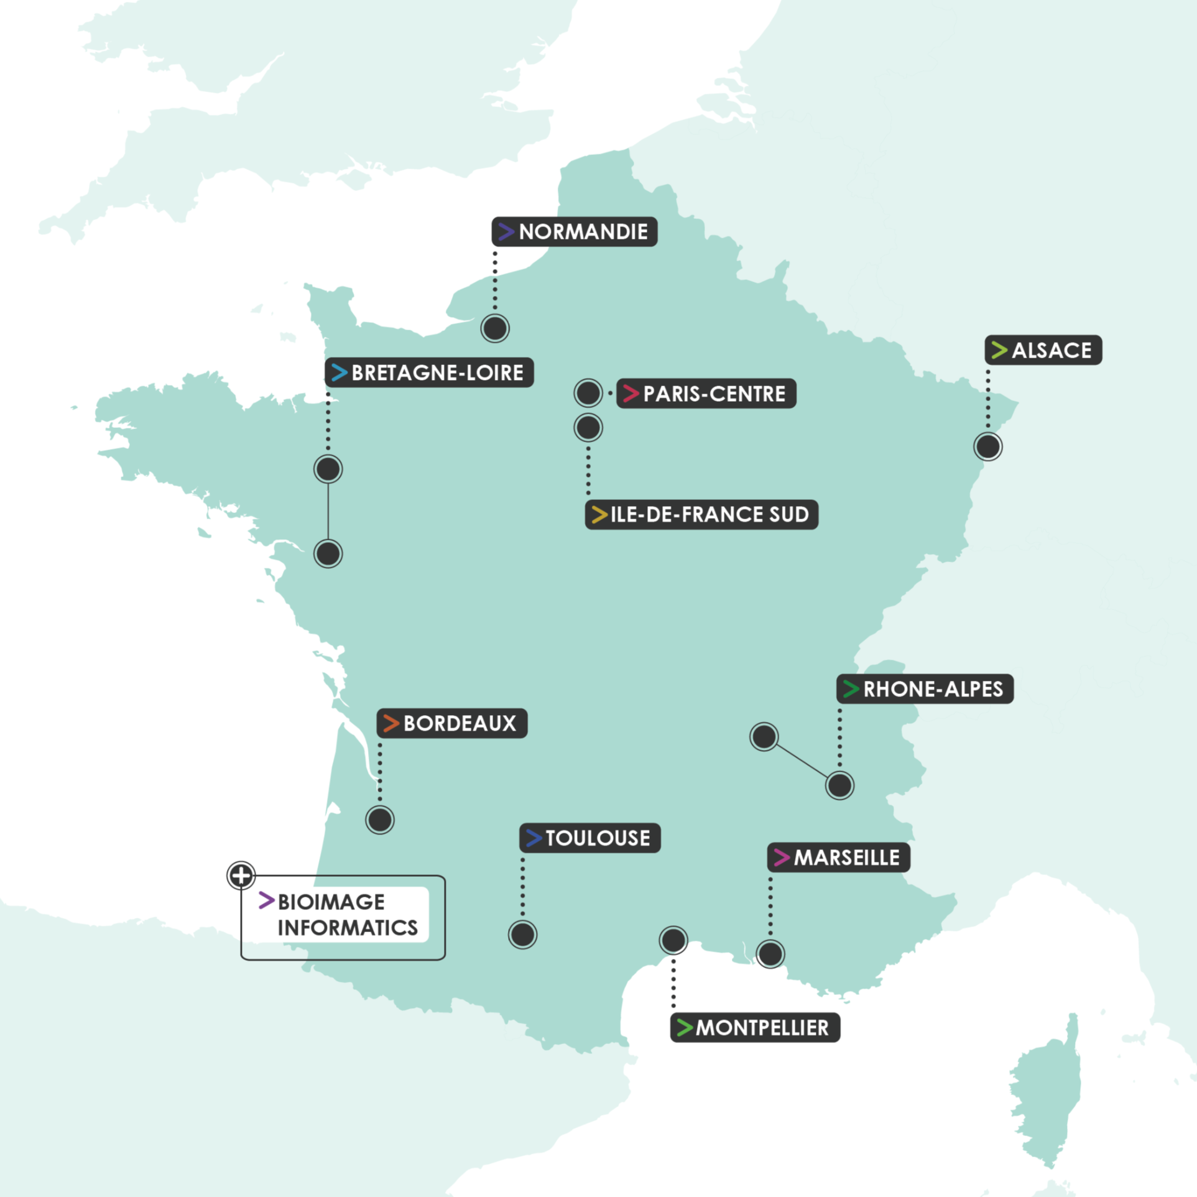







FRANCE-BIOIMAGING
The National Research Infrastructure for Biological Imaging
We are proud to be part of a France-BioImaging Node (supported by the ANR-24-INBS-0005 FBI BIOGEN), providing open access to imaging technologies & expertise
France-BioImaging in a nutshell:
11 nodes distributed across France
30 imaging core facilities
80 associated R&D teams
> 400 set-ups
france-bioimaging.org
france-bioimaging
Fr_BioImaging
france-bioimaging.bsky.social

Slide 2
FRANCE-BIOIMAGING
The National Research Infrastructure for Biological Imaging
We acknowledge support from the XXXX facility, a member of France-BioImaging (supported by ANR-24-INBS-0005 FBI BIOGEN), for access to imaging technologies and expertise.
France-BioImaging in a nutshell:
11 nodes distributed across France
30 imaging core facilities
80 associated R&D teams
> 400 set-ups
france-bioimaging.org
france-bioimaging
Fr_BioImaging
france-bioimaging.bsky.social

